Slide 1
Sorting

Slide 2
Problem – Write a program in 8086 microprocessor to sort numbers in ascending order in an array of n numbers, where size “n” is stored at memory address 2000 : 500 and the numbers are stored from memory address 2000 : 501.

Slide 3
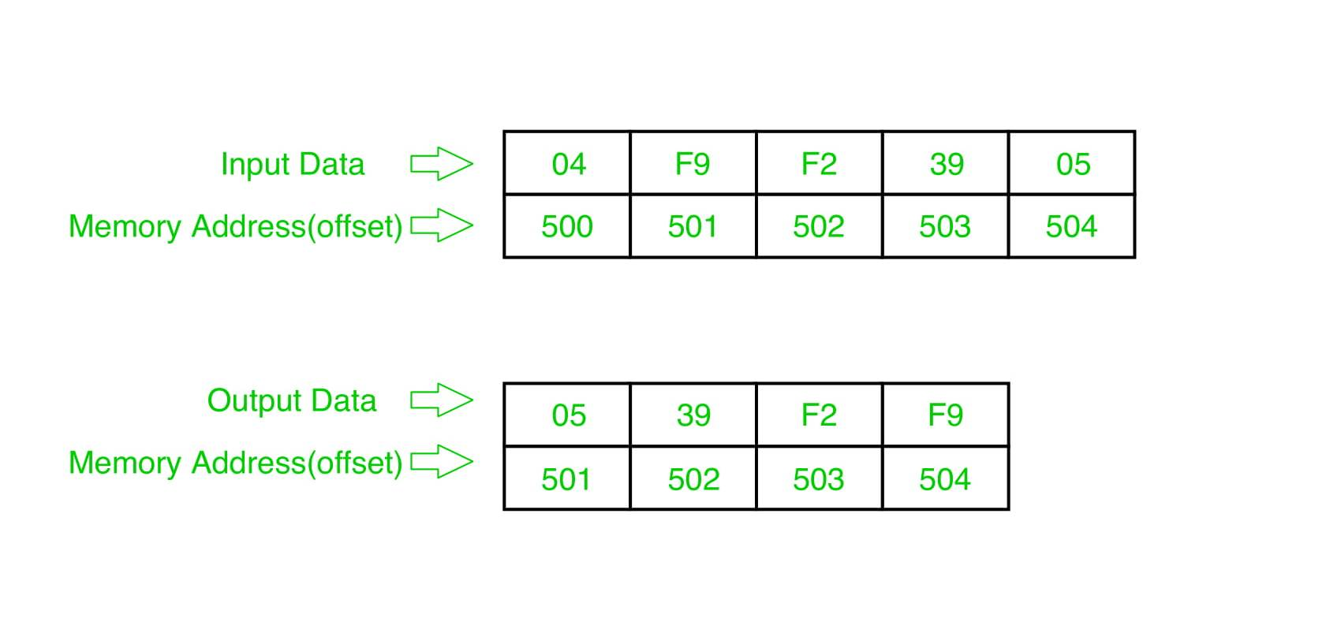
Example –

Slide 4
Algorithm
Load data from offset 500 to register CL (for count).
Travel from starting memory location to last and compare two numbers if first number is greater than second number then swap them.
First pass fix the position for last number.
Decrease the count by 1.
Again travel from starting memory location to (last-1, by help of count) and compare two numbers if first number is greater than second number then swap them.
Second pass fix the position for last two numbers.
Repeated.

Slide 5
Pass-1:
F9 F2 39 05
F2 F9 39 05
F2 39 F9 05
F2 39 05 F9 (1 number got fix)
Pass-2:
F2 39 05 F9
39 F2 05 F9
39 05 F2 F9 (2 number got fix)
Pass-3:
39 05 F2 F9
05 39 F2 F9 (sorted)

Slide 6
DATA SEGMENT
STRING1 DB 05h, 99H,12H,56H,45H,36H
DATA ENDS
CODE SEGMENT
ASSUME CS:CODE,DS:DATA
START: MOV AX,DATA
MOV DS,AX
LEA SI,string1
MOV CH,[SI]
INC SI
MOV DI,SI
UP2: MOV CL,CH
MOV SI, DI
UP1: MOV AL,[SI]
MOV BL,[SI+1]
CMP AL,BL
JC DOWN
MOV DL,[SI+1]
XCHG [SI],DL
MOV [SI+1],DL
DOWN: INC SI
DEC CL
JNZ UP1
DEC CH
JNZ UP2
MOV AX,04h
INT 21h
CODE ENDS
END START

Slide 7
Selection sort
Problem – Write an assembly language program in 8086 microprocessor to sort a given array of n numbers using Selection Sort.
Assumptions – The number of elements in the array is stored at offset 500. The array starts from offset 501.

Slide 8
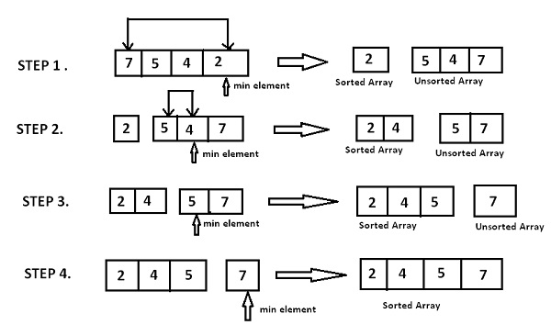
–
.
Example –

Slide 9
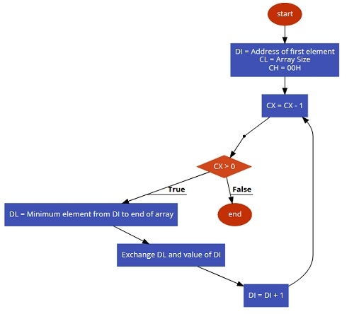

Slide 10
Algorithm –
We first find the smallest number in the array.
Swap the smallest number from the first element of the array.
Keep repeating the process till all elements are traversed.

